Slide 1
Fast Iterative Graph Computing with
Updated Neighbor States
Yijie Zhou¹, Shufeng Gong¹, Feng Yao¹, Hanzhang Chen¹, Song Yu¹,
Pengxi Liu¹, Yanfeng Zhang¹, Ge Yu¹, Jeffrey Xu Yu²
Northeastern University¹, The Chinese University of Hong Kong²

Slide 2
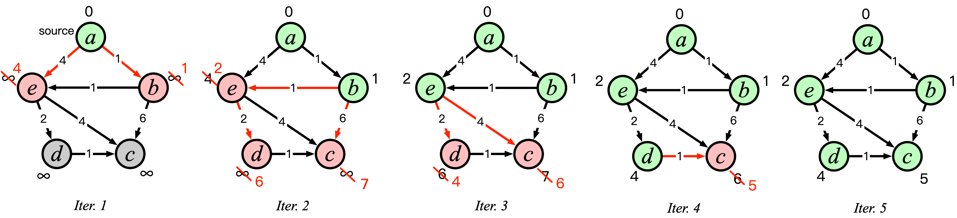
Iterative Computation
PageRank, SSSP, BFS, ……
Traversing the entire graph multiple times

Slide 3
Iterative Computation
PageRank, SSSP, BFS, ……
Traversing the entire graph multiple times
time consuming

Slide 4
Accelerate Iterative Computation
How to accelerate iterative computation?
Reduce the time per iteration
Decrease the number of iterations

Slide 5
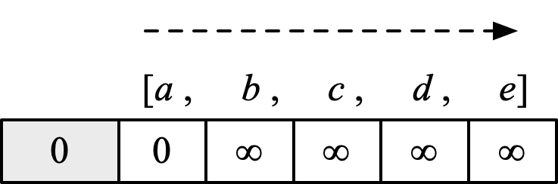
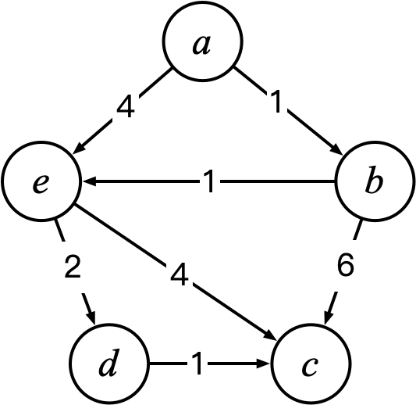
Vertex State Changes in Iterative Rounds
Synchronous

Slide 6
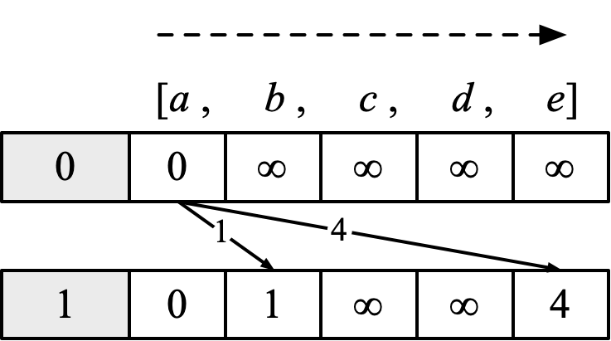
Vertex State Changes in Iterative Rounds
Synchronous

Slide 7
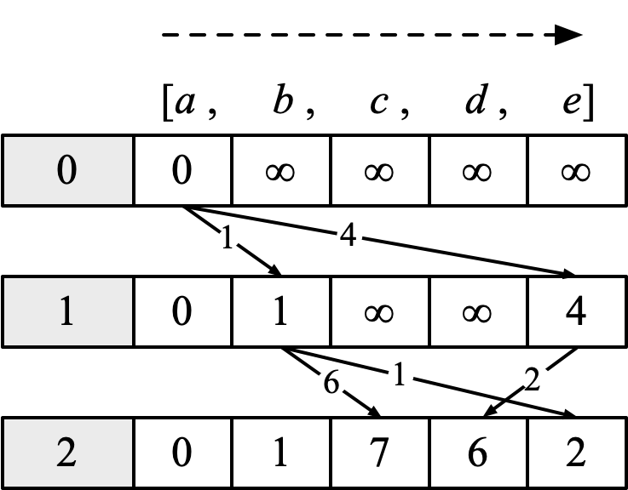
Vertex State Changes in Iterative Rounds
Synchronous

Slide 8
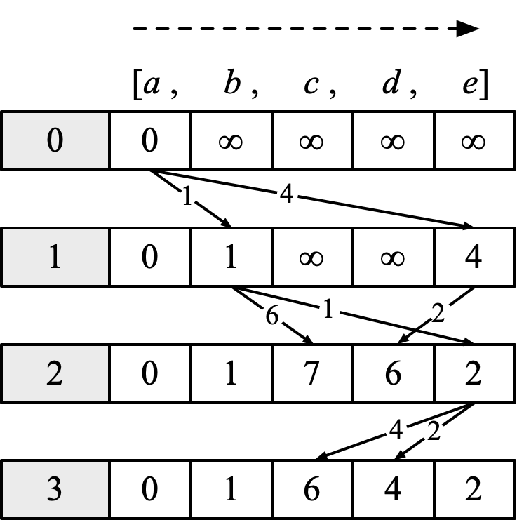
Vertex State Changes in Iterative Rounds
Synchronous

Slide 9
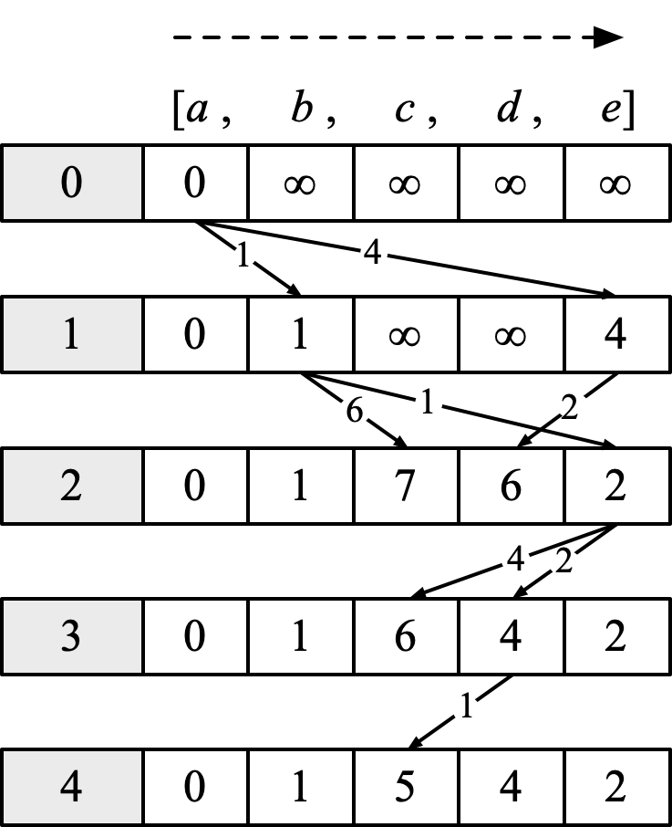
Vertex State Changes in Iterative Rounds
Synchronous

Slide 10
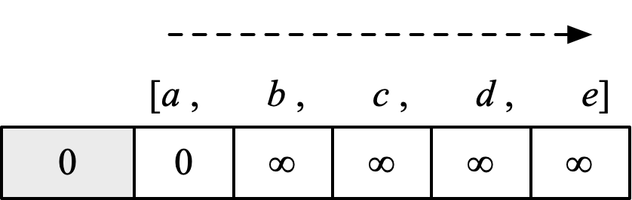
Vertex State Changes in Iterative Rounds
Synchronous
Asynchronous

Slide 11
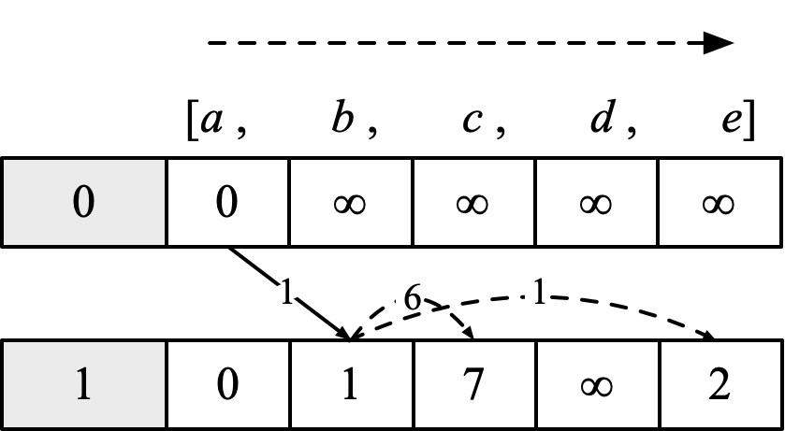
Vertex State Changes in Iterative Rounds
Synchronous
Asynchronous

Slide 12
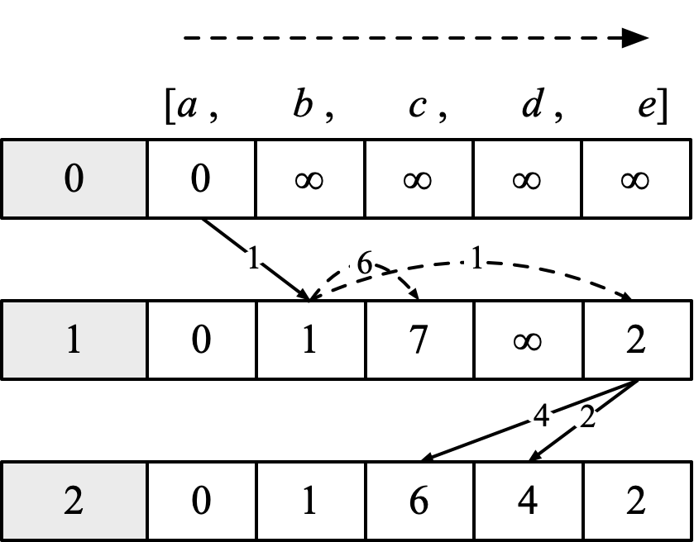
Vertex State Changes in Iterative Rounds
Synchronous
Asynchronous

Slide 13
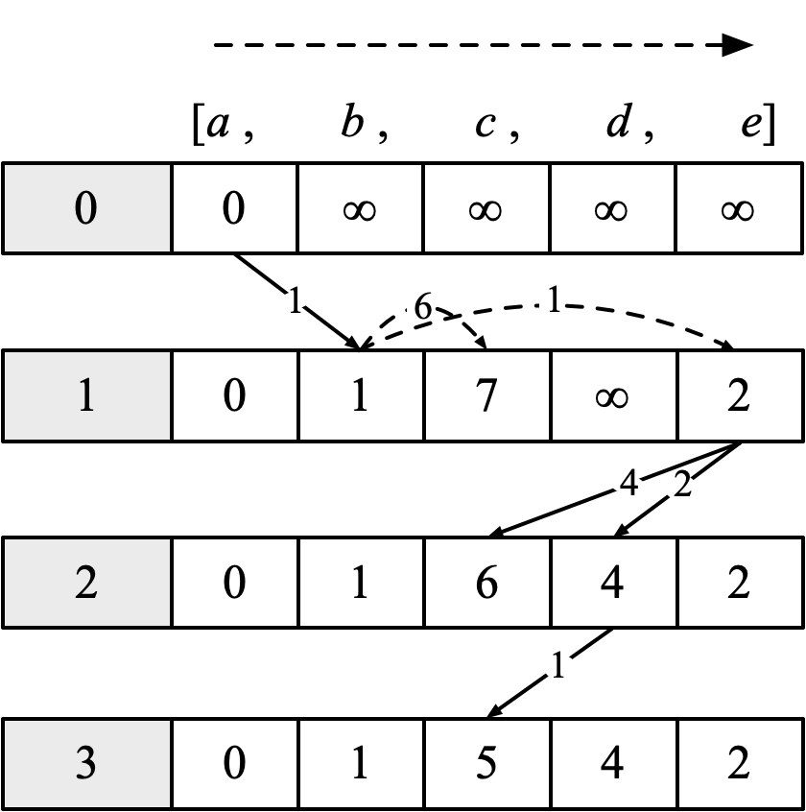
Vertex State Changes in Iterative Rounds
Synchronous
Asynchronous

Slide 14
Vertex State Changes in Iterative Rounds
Synchronous
Asynchronous
Asynchronous iteration reduces the number of rounds because each vertex can immediately use the latest state value.

Slide 15
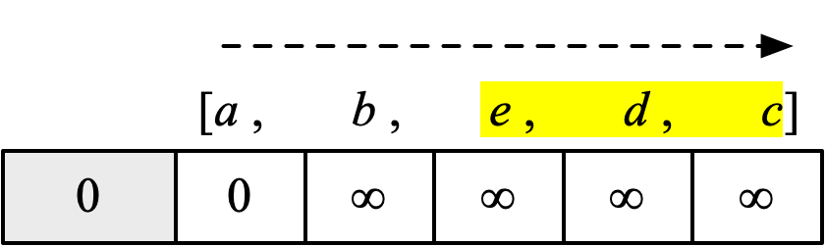
Vertex State Changes in Iterative Rounds
Asynchronous
with reordered order
Asynchronous

Slide 16
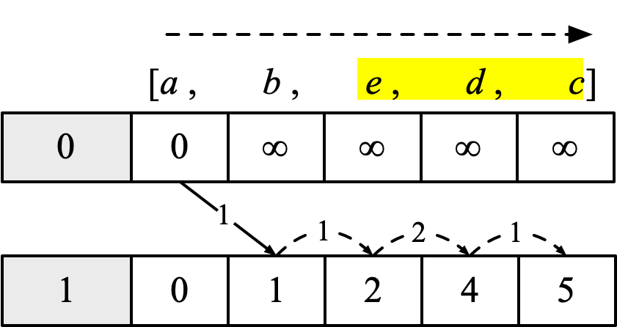
Vertex State Changes in Iterative Rounds
Asynchronous
with reordered order
Asynchronous

Slide 17
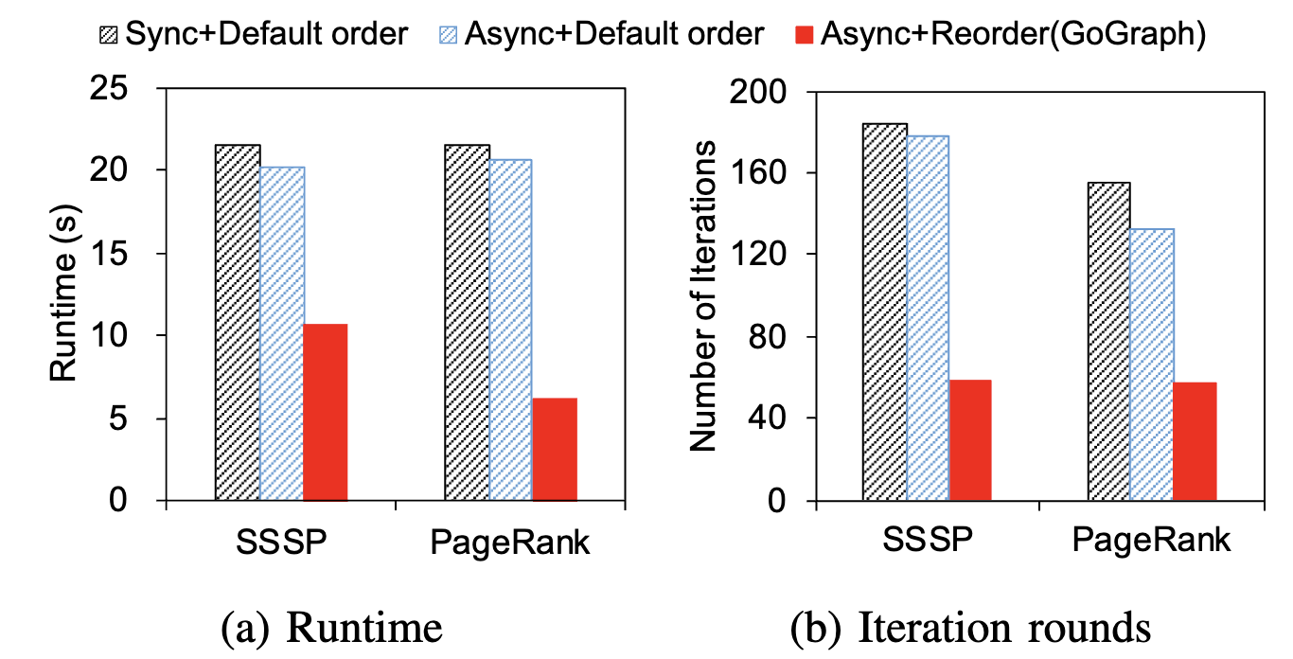
Converging Quicker After Reordering

Slide 18
Goal
Construct an efficient vertex processing order to accelerate the iterative computation.

Slide 19
Challenges
Which processing order is better?
Challenge 1. Design a metric to measure the quality of the processing order.
How to reorder the vertex to make the iterations converge faster?
Challenge 2. Design a vertex reordering method.

Slide 20

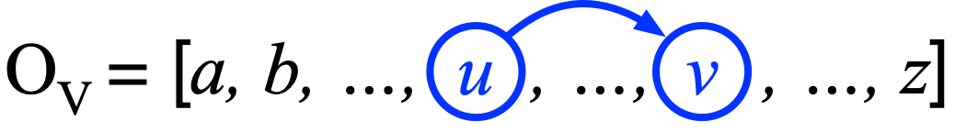
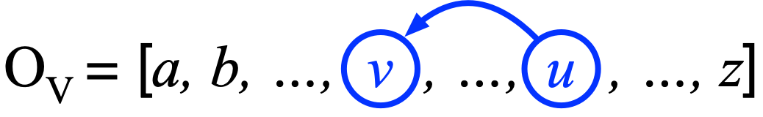
Positive/Negative Edge
For an existing edge:
Processing order 1:
<u,v> is a positive edge, since v can use u’s latest state in the same round.
Processing order 2:
<u,v> is a negative edge, since v can only use u's latest state in the next round.

Slide 21
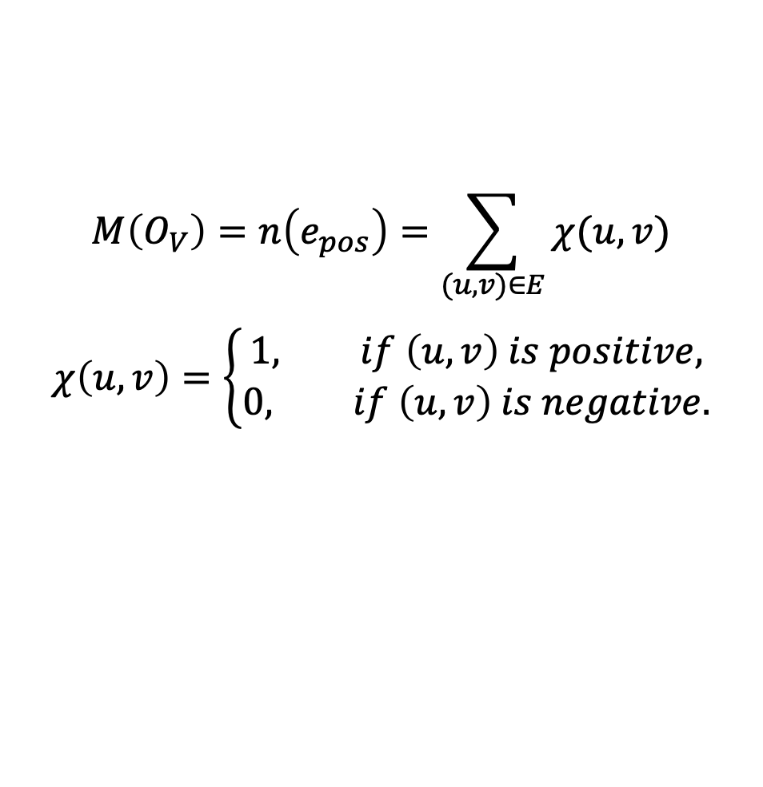
Metric Funtion
Intuition: as mentioned before, the more positive edges, the more vertex state values can be utilized per round, speeding up convergence.
Counts the number of positive edges ( , $u$ is processed prior to $v$)
$$M\left(O_{V}\right)=n\left(e_{pos}\right)=\sum_{(u,v)∈E}{χ(u,v)}$$
$$χ\left(u,v\right)=\left\{\begin{aligned}1, if \left(u,v\right) is positive, \\ 0, if \left(u,v\right) is negative.\end{aligned}\right.$$
The goal of our reordering method: maximize the quantity of positive edges

Slide 22
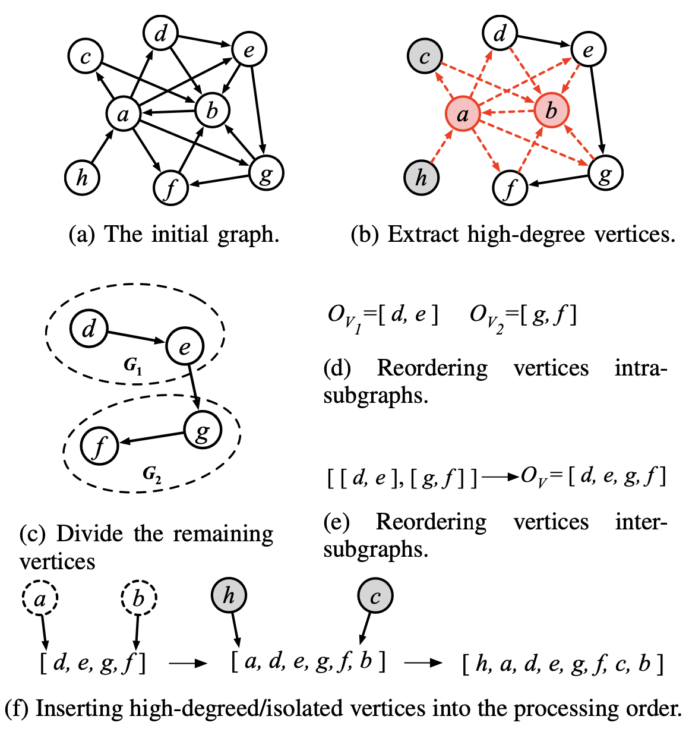
GoGraph
Extract high-degree and isolated vertices
Divide other vertices
Reorder vertices within subgraphs
Reorder subgraphs
Insert high-degree and isolated vertices

Slide 23
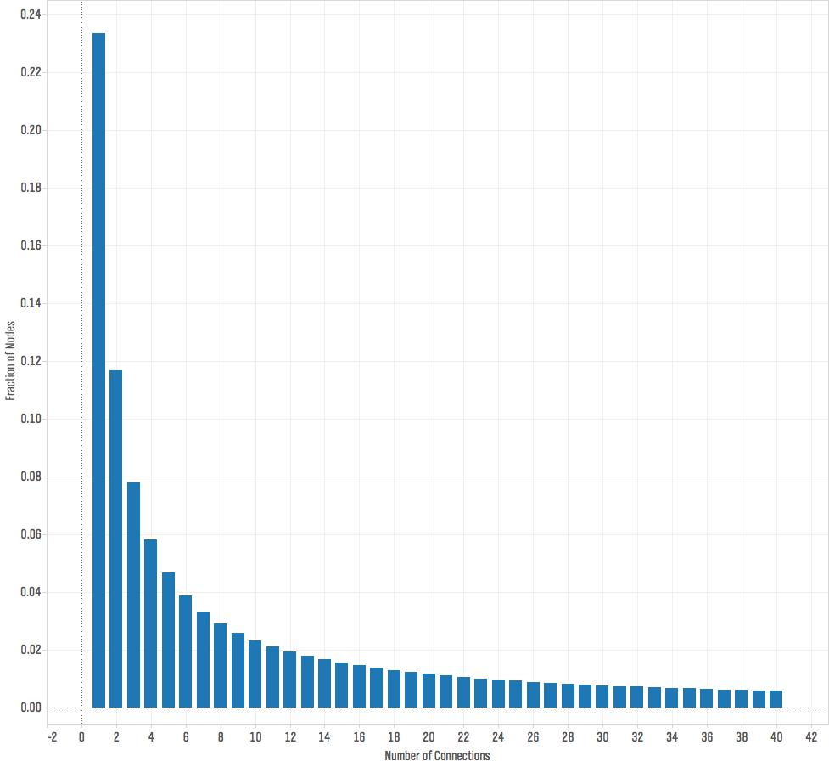
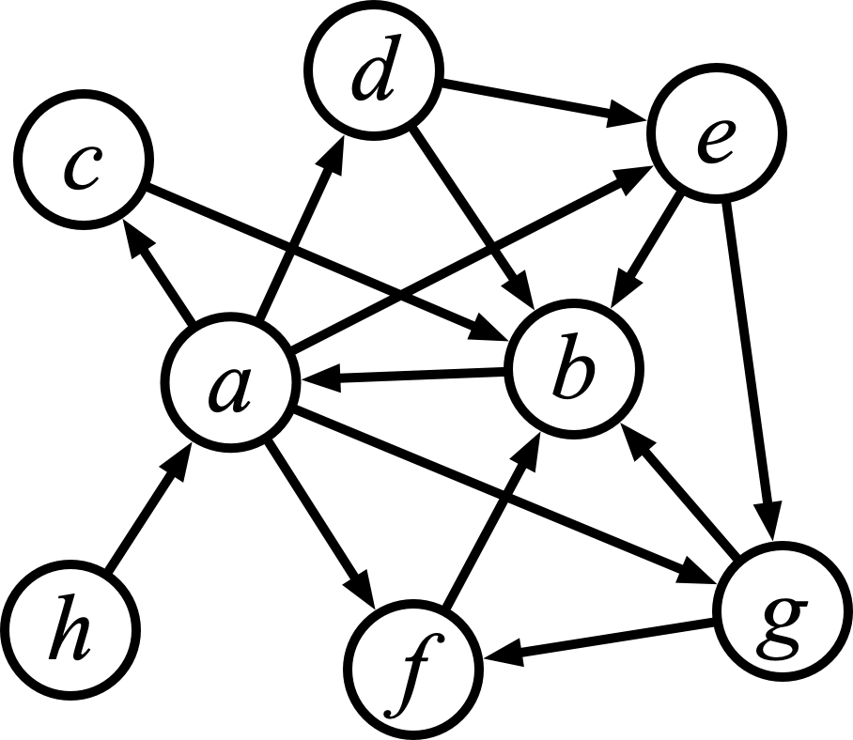
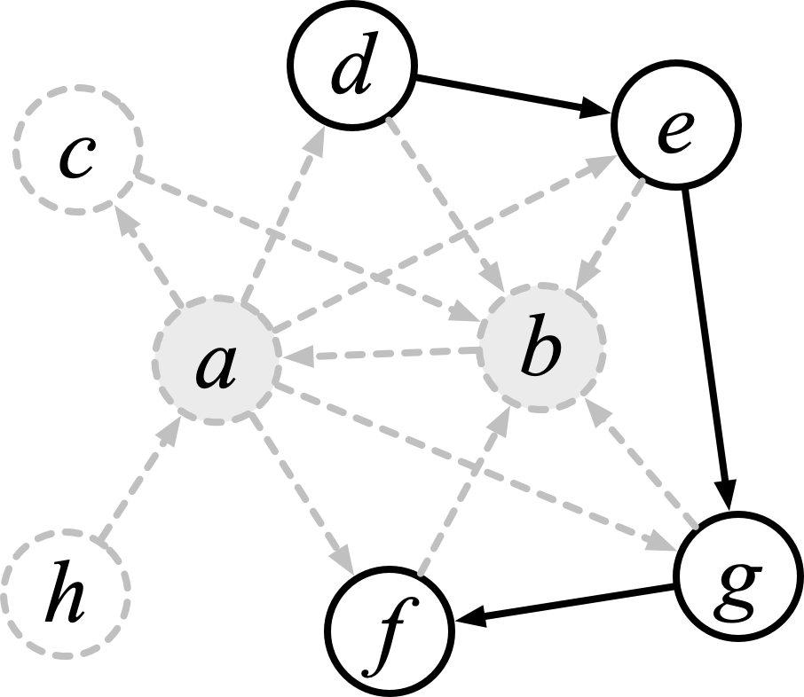
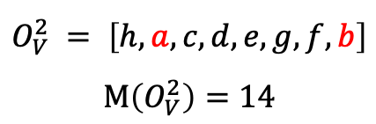
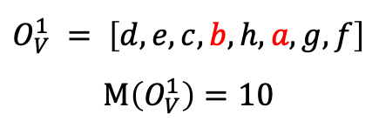
GoGraph
Extract high-degree and isolated vertices
$$O_{V}^{1} = \left[d, e, c, b, h, a, g, f\right]$$
$$M\left(O_{V}^{1}\right)=10$$
$$O_{V}^{2} = \left[﻿h, a, c, d, e, g, f, b\right]$$
$$M\left(O_{V}^{2}\right)=14$$
Distribution of vertices of different degrees for scale-free graphs

Slide 24
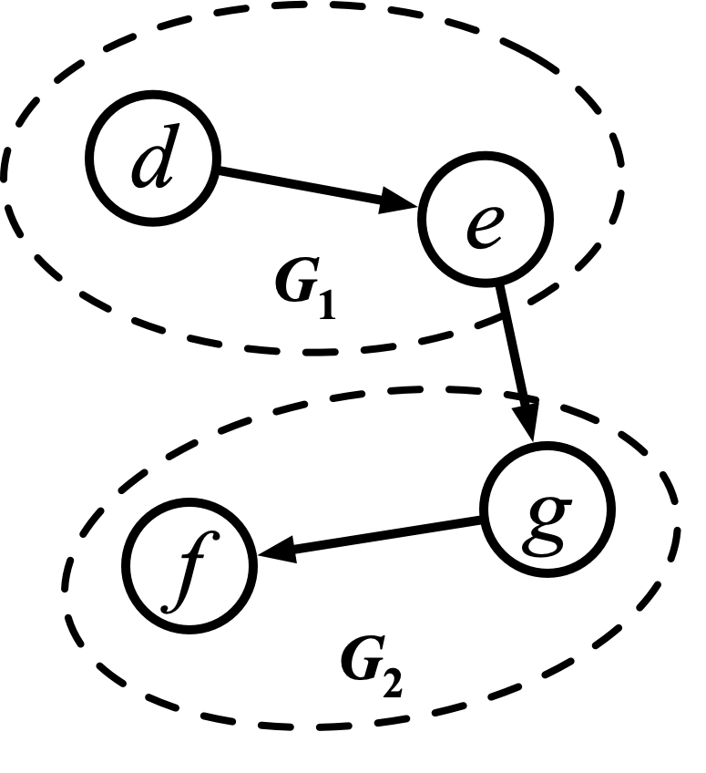
GoGraph
2) Divide other vertices
Louvain, Metis, …

Slide 25
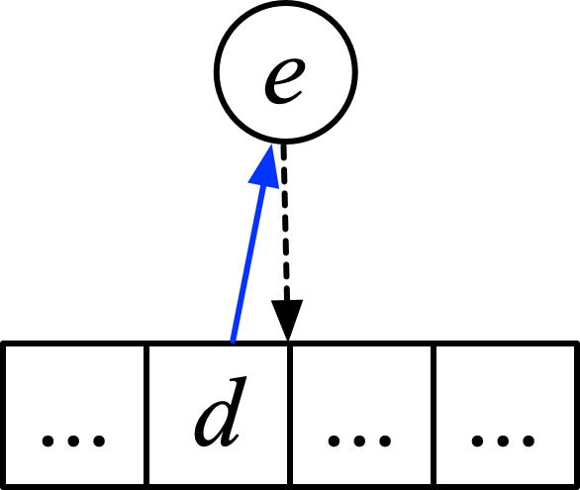
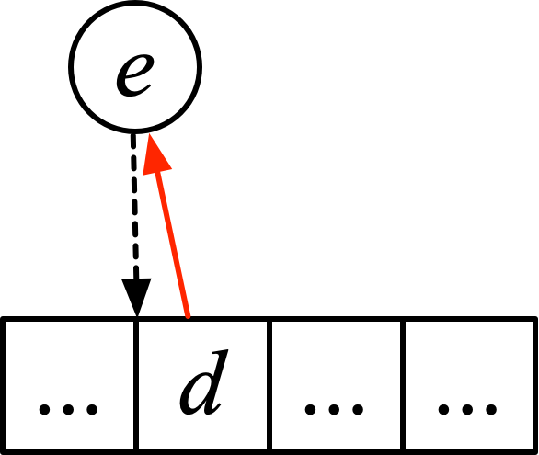
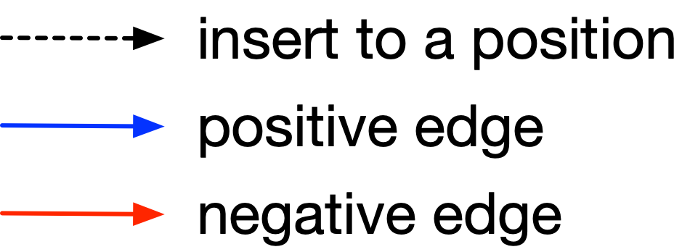
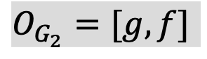
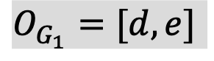
GoGraph
3) Reorder vertices within subgraphs
Calculate the M value based on where the vertices are inserted;
Find the position that maximizes M (maximize the number of positive edges and minimize the number of negative edges).
$$O_{G_{1}}=[d,e]$$
$$O_{G_{2}}=[g,f]$$

Slide 26
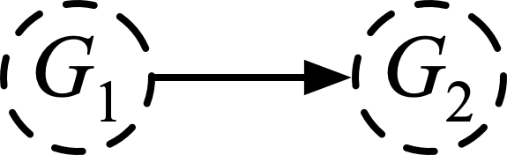

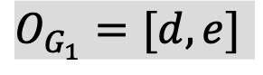
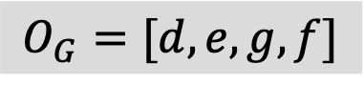
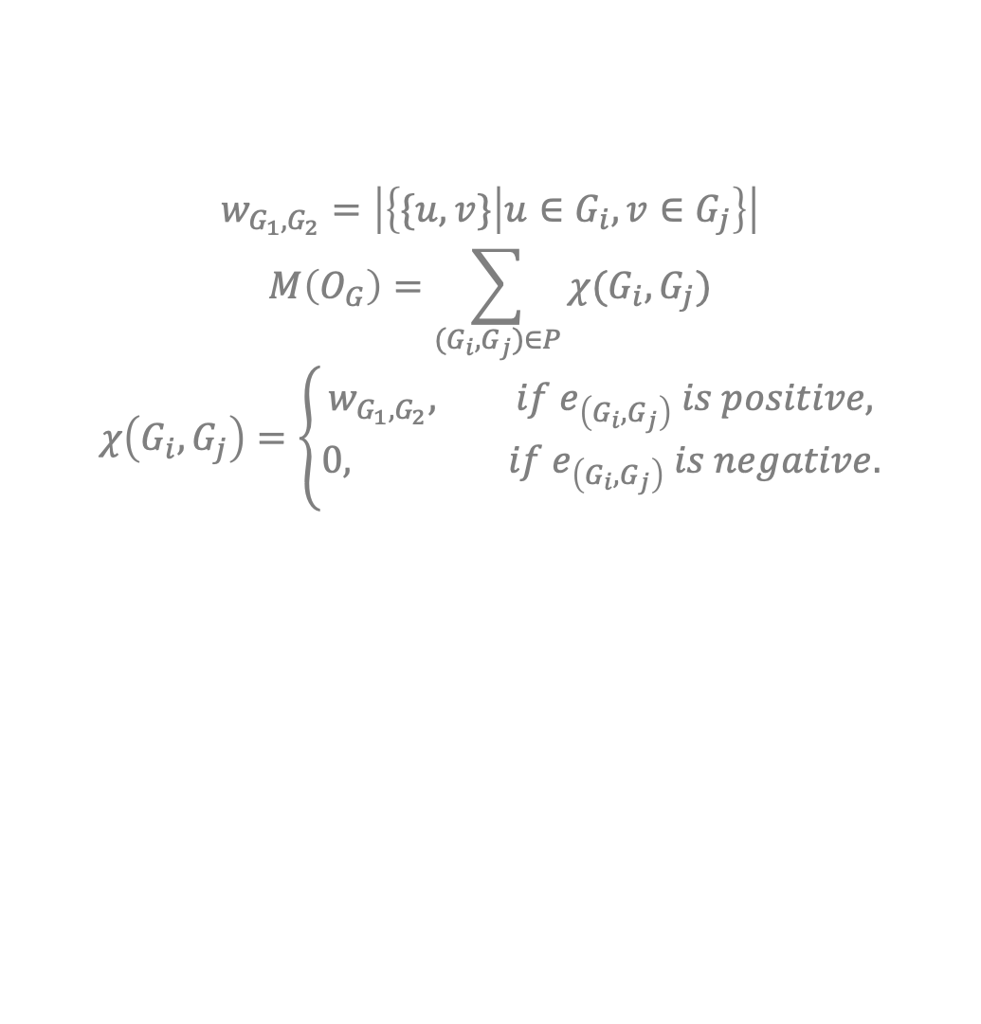
GoGraph
4) Reorder subgraphs
Consider each subgraph as a super vertex;
Perform the same operation in step 3.
$$w_{G_{1},G_{2}}=\left|\left\{\{u,v\} | u∈G_{i},v∈G_{j}\right\}\right|$$
$$M\left(O_{G}\right)=\sum_{(G_{i},G_{j})∈P}{χ(G_{i},G_{j})}$$
$$χ\left(G_{i},G_{j}\right)=\left\{\begin{aligned}w_{G_{1},G_{2}}, if e_{\left(G_{i},G_{j}\right)} is positive, \\ 0, if e_{\left(G_{i},G_{j}\right)} is negative.\end{aligned}\right.$$
$$O_{G_{1}}=[d,e]$$
$$O_{G_{2}}=[g,f]$$
$$O_{G}=[d,e,g,f]$$

Slide 27
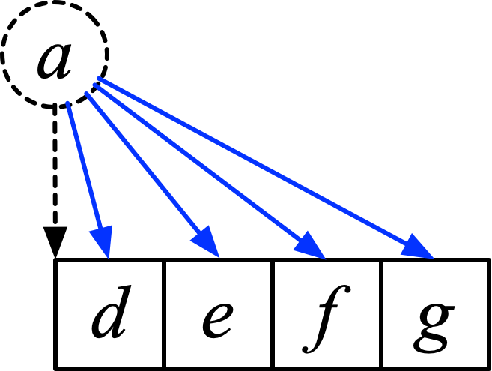
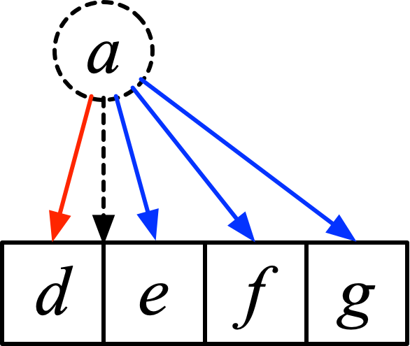
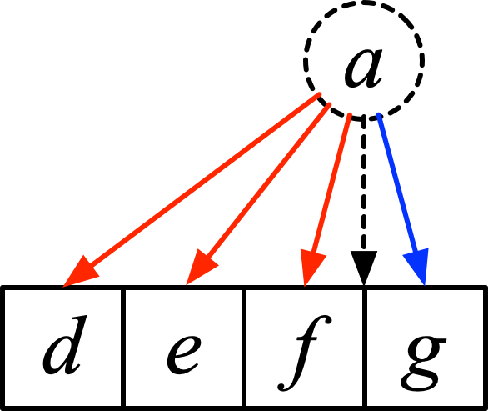
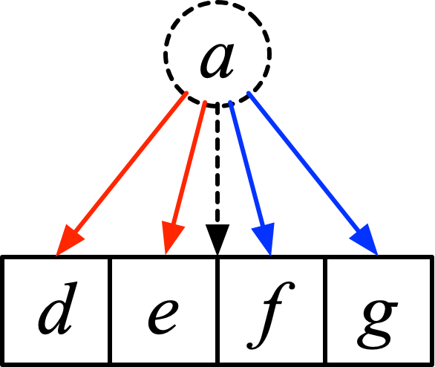
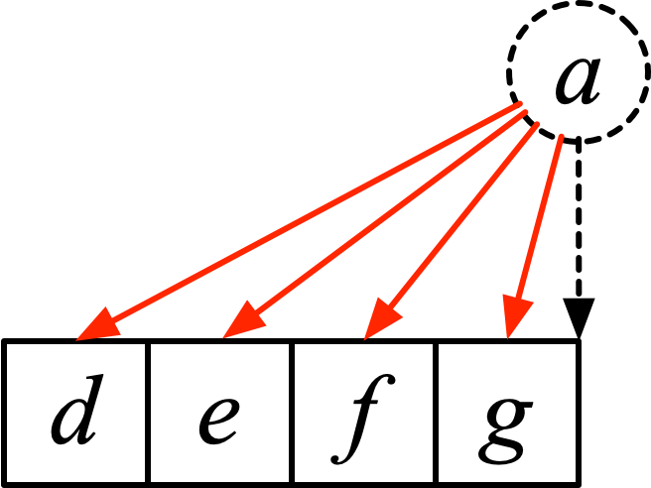
GoGraph
Insert high-degree and isolated vertices

Slide 28
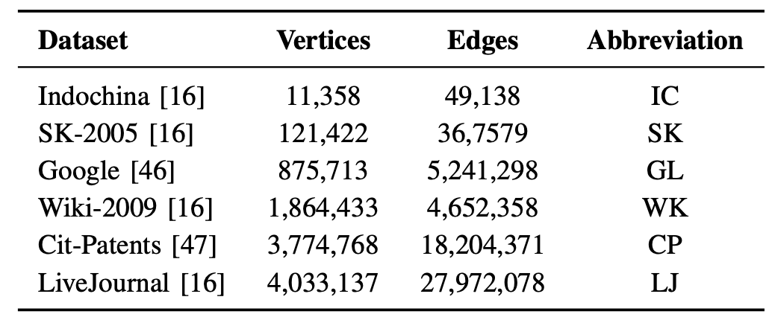
Experiments
Competitors
Degree Sorting, Hub Sorting, Hub Clustering, Rabbit, Gorder
Workloads
PageRank, SSSP, BFS, PHP
Environment
Linux server, 98 GB RAM, Ubuntu 22.04 (64-bit), GCC 7.5
Datasets

Slide 29
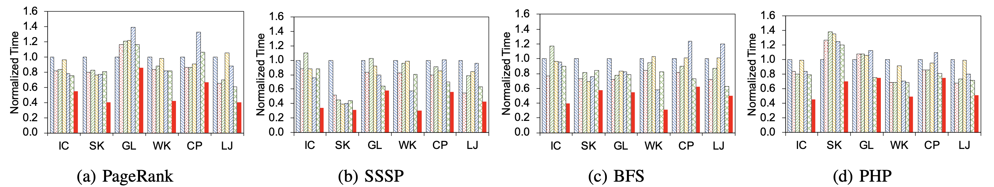
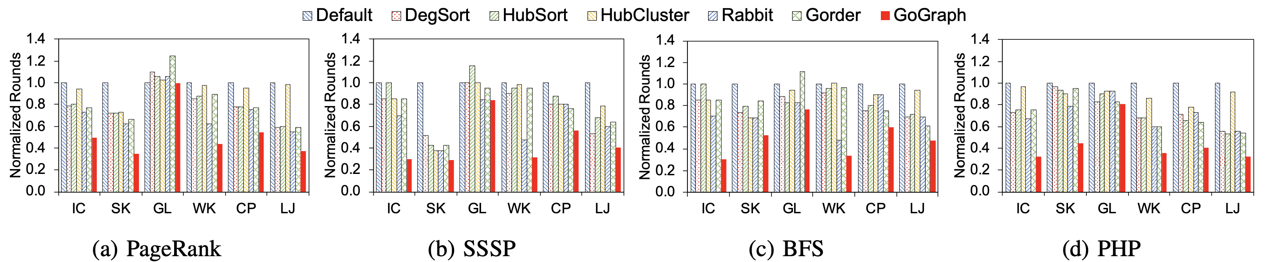
Overall performance
Fig. 1 The comparison of runtime
GoGraph outperforms competitors by an average of 1.83× in runtime.
Fig. 2 The comparison of iteration rounds
GoGraph outperforms competitors by 41% on average reduction in iteration rounds.

Slide 30
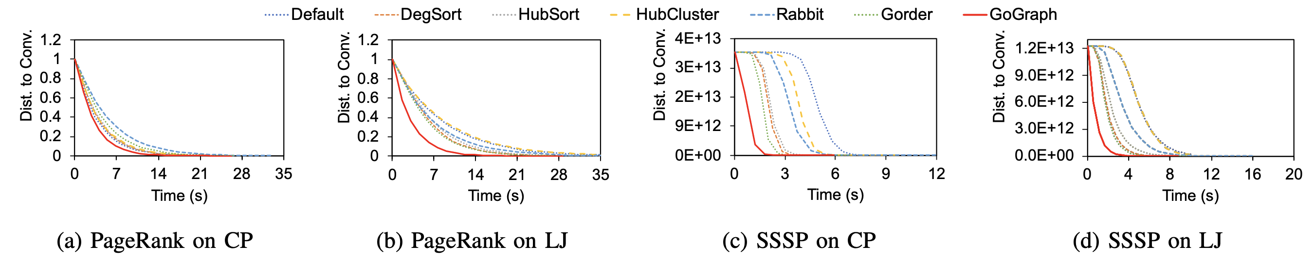
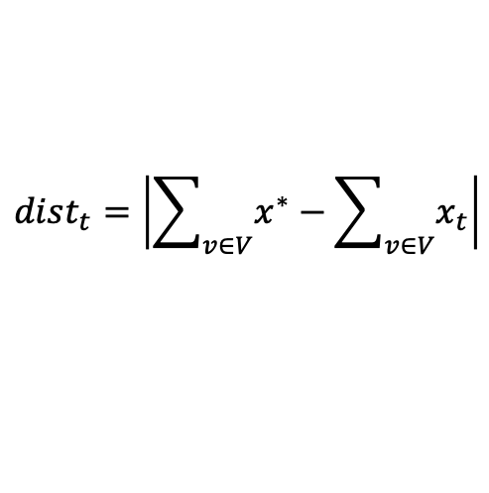
Convergence comparison
The distance from the state value at time t to the converged state value:
$${dist}_{t}=\left|\sum_{v∈V}{x^{∗}}−\sum_{v∈V}{x_{t}}\right|$$
Fig. 3 The comparison of convergence speed
GoGraph algorithm consumes 59% of the average time used by competitors (with a minimum requirement of 37%) to reach convergence.

Slide 31
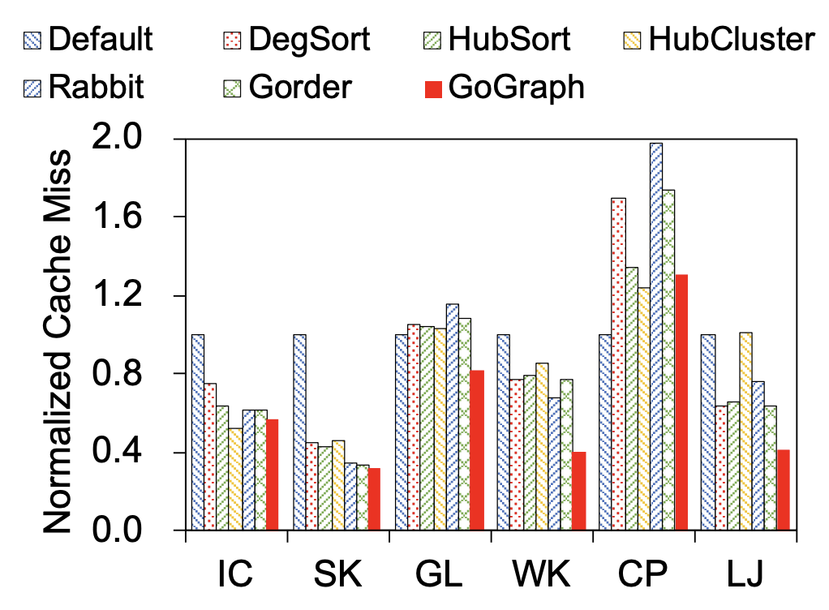
CPU cache miss
Fig. 4 The comparison of CPU cache miss
GoGraph can reduce the cache miss by 30% on average.

Slide 32
Conclusion
We propose GoGraph, a graph reordering algorithm
We propose a metric to measure the efficiency of the vertex processing order

Slide 33
Thank you for listening!

